Slide 1
Photography year 9-11
Flynn Foster

Slide 2
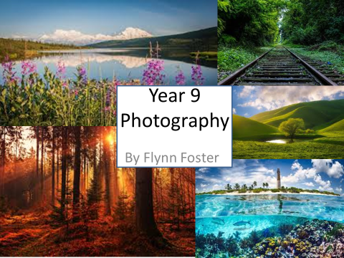

Slide 3
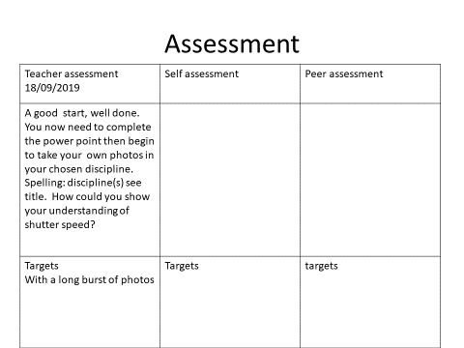

Slide 4
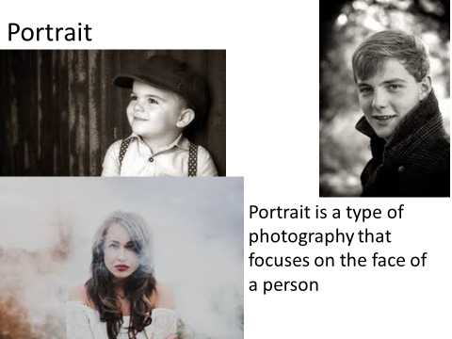

Slide 5
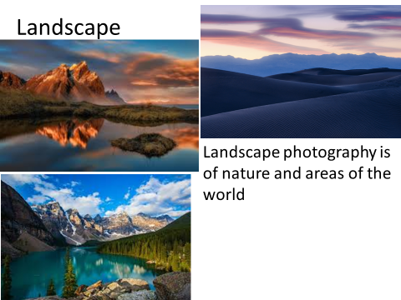

Slide 6
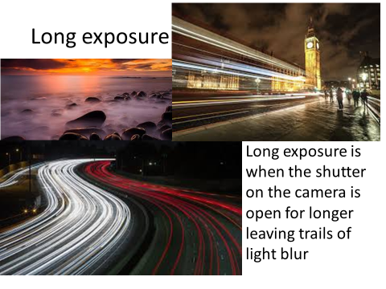

Slide 7
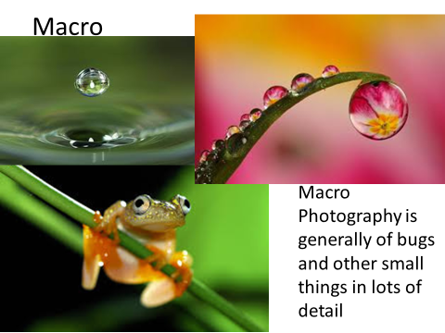

Slide 8
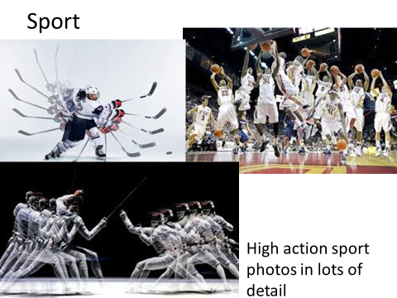

Slide 9
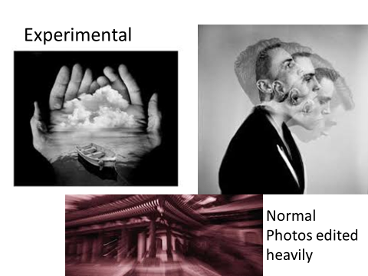

Slide 10
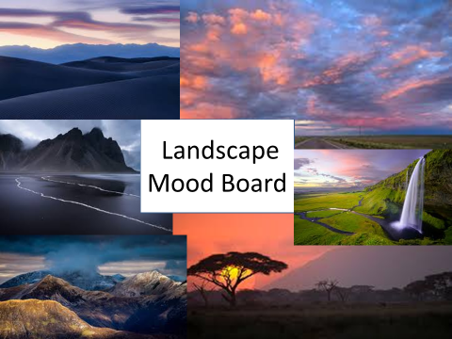

Slide 11
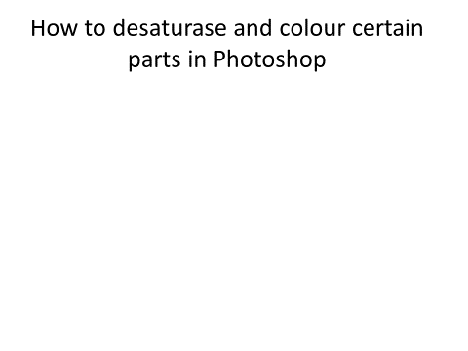

Slide 12
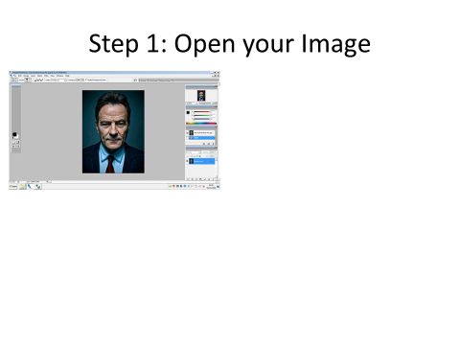

Slide 13
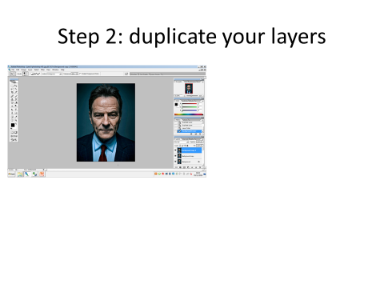

Slide 14
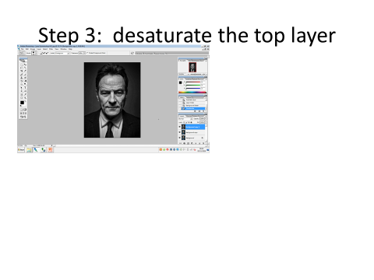

Slide 15
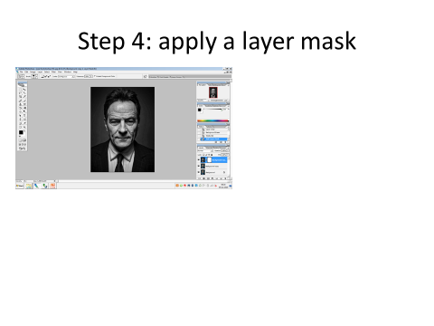

Slide 16
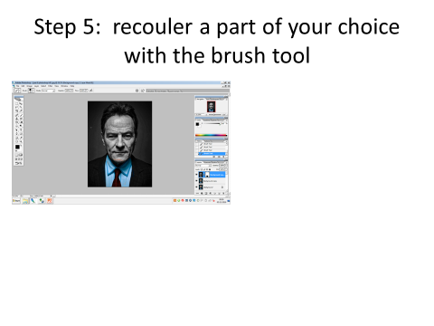

Slide 17
SHUTTER SPEED
YEAR 9

Slide 18
Shutter Speed
By Flynn Foster

Slide 19
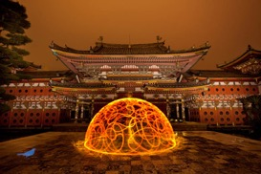
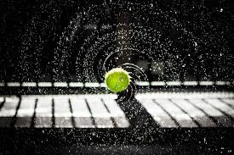
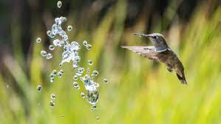
Shutter speed photography
Shutter speed photography is the speed that the camera shutter opens and closes at.
A fast shutter speed will let less light in and create a darker sharper image
A slow shutter speed image will let more light in and will create a lighter more blurry image
Trevor Williams is an example of a well known photographer who uses slow shutter speed to create ”light drawings” here is an example of his work:

Slide 20

Shutter speed analysis
Here is a good example of slow shutter speed photography. I like the effect of the image, and the way the light looks. The photographer has clearly used a slow shutter speed to create this image. I will take inspiration and use light and slow shutter speed to create a similar image.

Slide 21
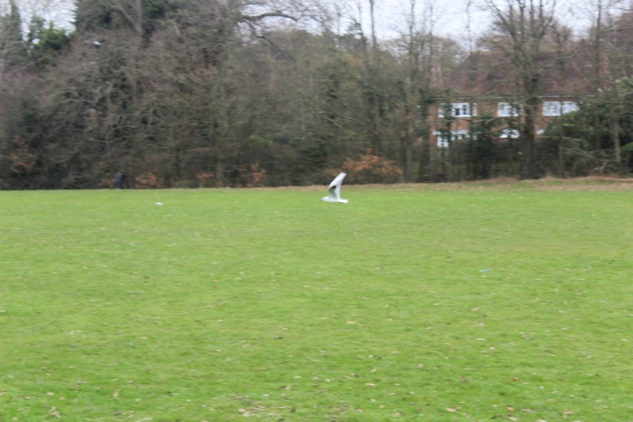
Shutter speed practical
This is my shutter speed practical.
I used fast shutter speed, however because the bird is still blurry I would have to use faster speed to get it in focus.
I like the way it turned out. Next time I am going to stick to the plan and take a light photograph instead. I like the blur on the wings that was caused by fast shutter speed.

Slide 22
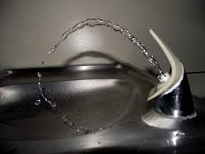
Fast shutter speed planning
I am going to recreate this by using a fountain and fast shutter speed

Slide 23
DEPTH OF FIELD
YEAR 9

Slide 24
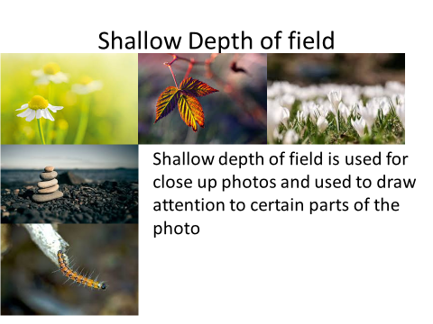

Slide 25
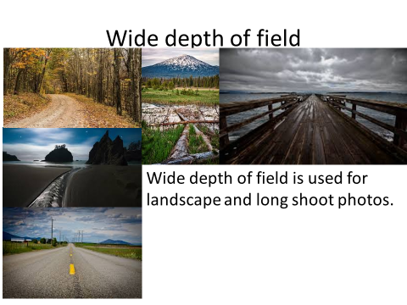

Slide 26
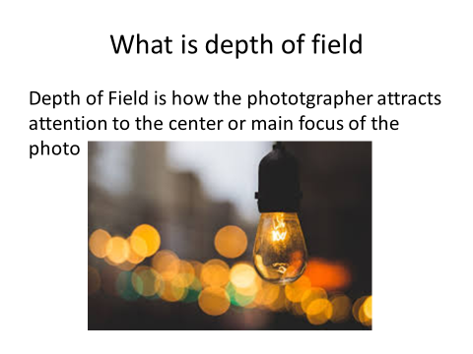

Slide 27
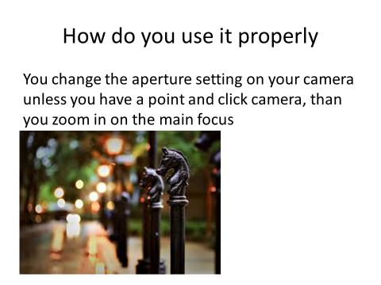

Slide 28
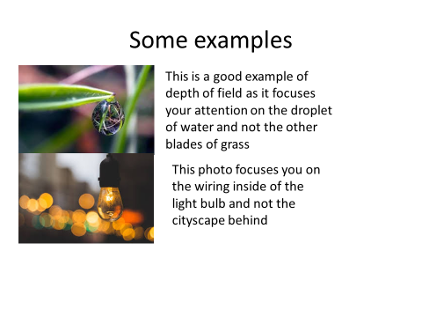

Slide 29
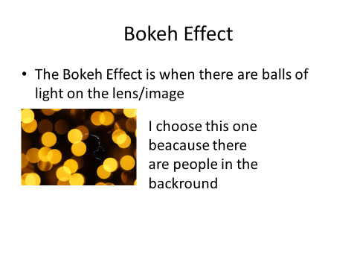

Slide 30
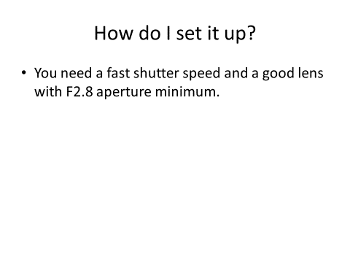

Slide 31
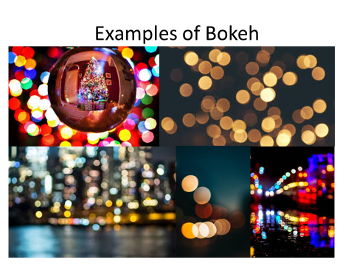

Slide 32
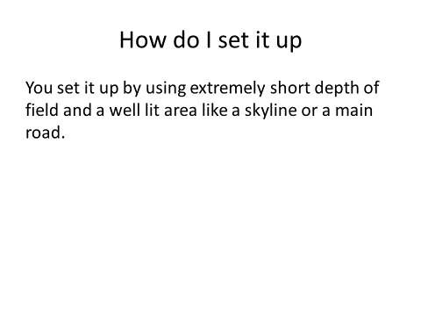

Slide 33
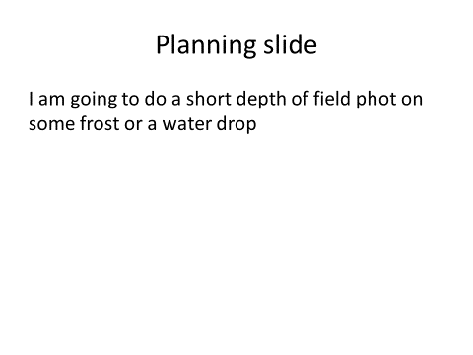

Slide 34
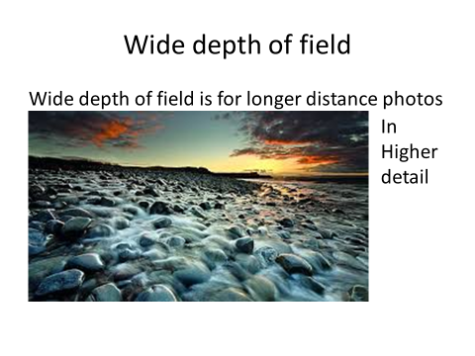

Slide 35
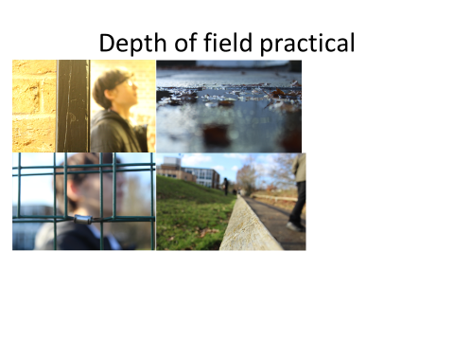

Slide 36
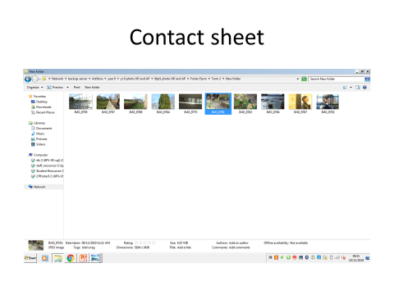

Slide 37
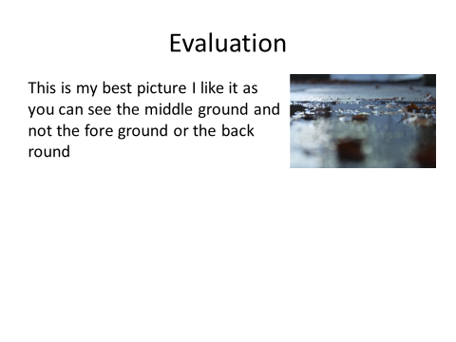

Slide 38
MACRO
YEAR 9

Slide 39
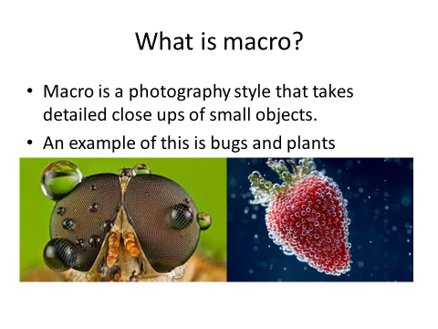

Slide 40
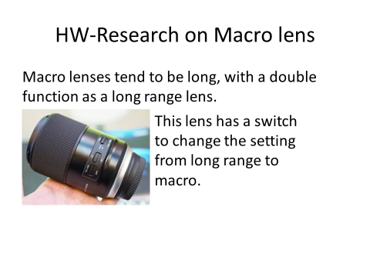

Slide 41
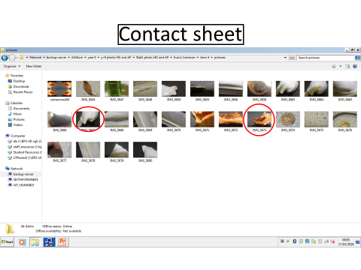

Slide 42
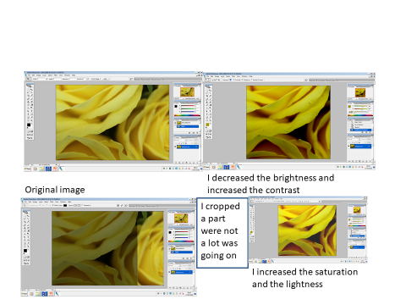

Slide 43
DOUBLE EXPOSURE
YEAR 9

Slide 44
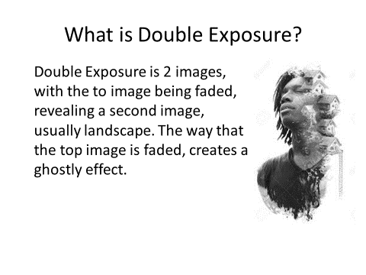

Slide 45
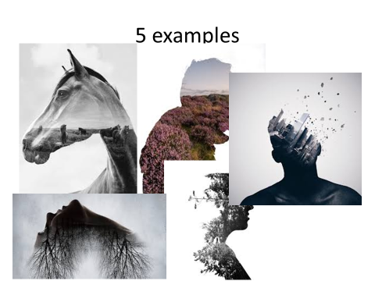

Slide 46
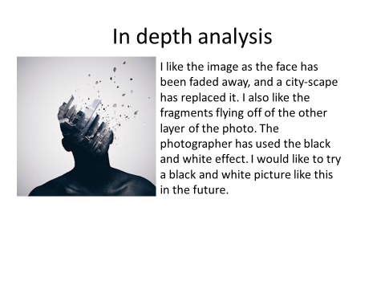

Slide 47
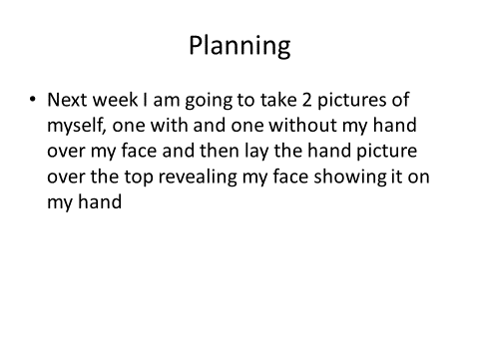

Slide 48
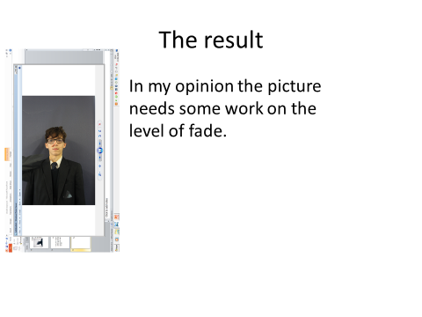

Slide 49
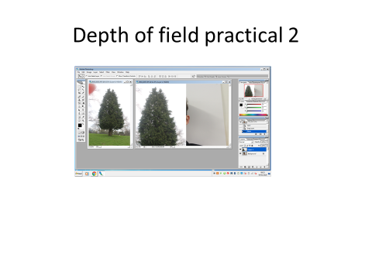

Slide 50
A-Z CHALLENGE
YEAR 9

Slide 51
Visual Alphabet
By Flynn Foster

Slide 52
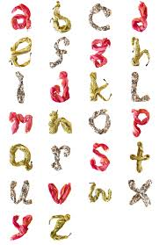
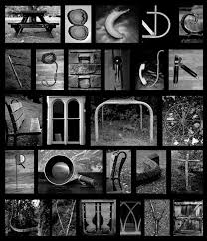
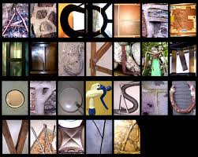
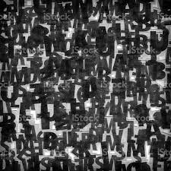
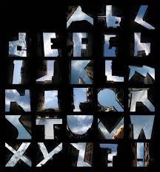
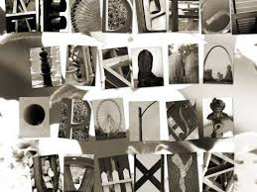


Research Slide
Visual Alphabet is showing letters through everyday items, such as buildings or furniture.

Slide 53
Peter de

Slide 54
YEAR 10
FLYNN FOSTER

Slide 55
PHOTO CHALLENGE
YEAR 10

Slide 56


Slide 57


Slide 58


Slide 59


Slide 60


Slide 61


Slide 62


Slide 63
NICHOLAS GOODDEN
YEAR 10

Slide 64


Slide 65


Slide 66


Slide 67


Slide 68
LAURA WILLIAMS
YEAR 10

Slide 69


Slide 70


Slide 71


Slide 72


Slide 73


Slide 74


Slide 75


Slide 76
MULTIPLE EXPOSURE
YEAR 10

Slide 77


Slide 78


Slide 79


Slide 80


Slide 81


Slide 82
YEAR 11
FLYNN FOSTER

Slide 83
PORTRAITURE
YEAR 11

Slide 84

Chuck Close research
Chuck Close was born in July 1940. He made abstract portraits of himself and others. He was paralysed in 1988. He is also a painter. He is famous for his photography style being very abstract.

Slide 85







Chuck Close mood board

Slide 86
Photographer & Image Name:
Website link:
Date of work:
1.Chuck Close's photography style is very abstract, and includes a lot of editingDescribe the look of the image. When was the image taken? What is the photographer trying to communicate about with this image?
2.What kind of photography is this? Can you think of the technical terms you need to describe this type of work effectively? Research what these specific types are and try to show your knowledge of the process of this technique in your analysis- include shutter speed, depth of field and any equipment used.
3.How is this a successful image? Consider specific formal elements and how the photographer has used these to make the image successful. Explain how the photographer engages the viewer and explores the context of the image(person, place and time) by using specific formal elements. (Colours, background, pose, expression, composition, cropping, lighting, DOF, polaroid)
4.What is the photographer trying to communicate with the viewer? How is this communicated, how have they directed the viewer to this?
5.What ideas will you take from this? How will you use this as inspiration? Can you be specific about how you might develop your own ideas in response? Do you have a concept that you want to demonstrate in your own work which could take inspiration from this? What will YOUR message be and how will you communicate it?

Slide 87
David Bailey research
David Bailey was born in 1938 on the 2nd of January. He is known for photographing many famous fashion models and other celebrities. His style was portrait.

Slide 88




David Bailey mood board

Slide 89
Photographer & Image Name:
Website link:
Date of work:
1. It looks abstract, and has been edited to be black and white.
2.It is portrait photography. Abstract, Portrait, edited.
3. I think it is successful at being a good black and white portrait. They used tone on his face to contour. The photo engages the viewer by using tone on his face to create detail.
4..He is trying to communicate that he is from an older generation. This is communicated by the fact that he is holding a gasmask.
5. I will take ideas from this, some of these are holding something that shows i am from this generation. I am taking inspiration from Chuck Close because I like his photographic style.

Slide 90

My edit
This is my Chuck Close edit. I think it was a good photo and edit but I think it could be better if it was taken with the camera portrait. Next time I will have the camera rotated so its portrait. I will also make the person I am photographing stand straight and look at the camera to make the image easier to work with.

Slide 91
Plan:
I am thinking of photographing Jamie. I am going to turn the camera so it is portrait. I am then going to edit the photo so it is black and white. Im going to take the picture from straight on.
N 0

Slide 92
Planning My Response
Elements to consider: | Your notes (write in as much detail as you can)
Who? | Jamie Saul Paul
Costume, props, pose, expression
Where? | Outside/studio
Lighting | Camera flash/studio light
Composition/arrangement
Artist links and inspiration | Chuck Close
Edit ideas | Black and white, moody
TASK:
INCLUDE YOUR RESPONSE PHOTOSHOOT PLAN:
What? Are you going to be doing...
Who? Will be in your photos...
Where? Will you take your photos...
How? Will you create shadow/highlight
Why? Have you chosen this artist...

Slide 93

Complete edit 2
This is my complete edit. I like the way it turned out. Next time I should make sure that the camera lens is focused and I have the camera portrait.

Slide 94
Plan
What? I am going to be taking some portrait images.
Who? Jamie, Paul, Saul.
Where? Outside somewhere with a clear background.
How? I will create a shadow highlight when i’m editing.
Why? I'm going to take inspiration from David Bailey.

Slide 95
DAVID HOCKNEY
YEAR 11

Slide 96

Research page David Hockney
David Hockney is a photographer and artist he was born on the 9th of July 1937. He sold 2 pieces for 40 million. He mostly does Abstract Portrait and Joiner photography. He made joiners because he dislikes photos that are executed with a wide angle lens. He sold a painting in 2018 for 70.7 million pounds at auction.
Key words:
Abstract
Layered
Puzzle
Colour

Slide 97

David Hockney Analysis
This image is of a man of a man smoking and looking around. This type of photography is called a joiner. This image is successful at showing how everyone thinks differently and has different opinions. He is trying to communicate that different opinions on different things, and that everyone is different. I will use the joiner style in my own edit, showing different angles.

Slide 98





Contact sheet

Slide 99

Transcription
This is my transcription. I got the eyes in the middle and the tie at the bottom like the original. I don't like the way it has turned out. I think to improve it next time I should take more photos to improve the variety.

Slide 100







Contact sheet

Slide 101

Standing edit
This is my standing edit. I like how it turned out. It is inspired by David Hockney’s photography. It is multiple pictures of Paul standing by a wall. This type of photography is called joiner photography. It is a few pictures of Paul edited onto one another and layered.

